Slide 1
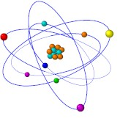
Carbon Chemistry
OCR module 13
W Richards
Worthing High School

Slide 2
Alkanes
Alkanes are SATURATED HYDROCARBONS. What does this mean?
  HYDROCARBONS are molecules that are made up of hydrogen and carbon atoms
  SATURATED means that all of these atoms are held together by single bonds, for example:
Ethane
Butane
Alkanes are fairly unreactive (but they do burn well).

Slide 3
General Formulae for Alkanes
Instead of circles, let’s use letters…
H
H
H
H
C
H
H
C
C
H
H
H
H
Methane (n=1)
Ethane (n=2)
H
H
H
H
H
H
H
H
C
C
C
H
H
C
C
C
C
H
H
H
H
H
H
H
H
Propane (n=3)
Butane (n=4)
General formula for alkanes = C_{n}H_{2n+2}

Slide 4
Alkenes
Alkenes are different to alkanes; they contain DOUBLE COVALENT bonds. For example:
ALKANES
Ethane
Ethene
ALKENES
Butane
Butene
This double bond means that alkenes have the potential to join with other molecules – this make them REACTIVE. We can test for alkenes because they turn bromine water colourless.

Slide 5
General Formulae for Alkenes
H
H
H
C
C
H
Ethene (n=2)
H
H
H
H
H
H
H
H
C
C
C
H
H
C
C
C
C
H
H
H
H
Propene (n=3)
Butene (n=4)
General formula for alkenes = C_{n}H_{2n}

Slide 6
Addition Reactions
H
H
H
H
H
C
C
H
+
H
H
H
C
C
H
H
H
Ethene
Hydrogen
Ethane
H
H
H
H
H
C
C
H
+
Br
Br
H
C
C
H
Br
Br
Ethene
Bromine
1,2 dibromoethane

Slide 7
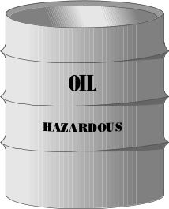
Hydrocarbons and crude oil
Crude oil is a mixture of HYDROCARBONS (compounds made up of carbon and hydrogen). Some examples:
H
H
Longer chains mean…
Less ability to flow
Less flammable
Less volatile
Higher boiling point
H
C
C
H
H
H
Ethane
Increasing length
H
H
H
H
H
C
C
C
C
H
H
H
H
H
Butane

Slide 8
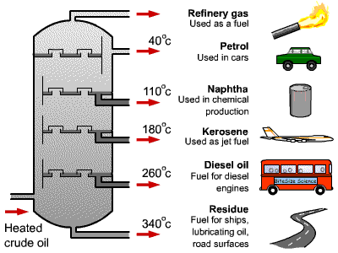
Fractional distillation
Crude oil can be separated by fractional distillation. The oil is evaporated and the hydrocarbon chains of different lengths condense at different temperatures:
Fractions with low boiling points condense at the top
Fractions with high boiling points condense at the bottom

Slide 9
Cracking
Shorter chain hydrocarbons are in greater demand because they burn easier. They can be made from long chain hydrocarbons by “cracking”:
Butane
Ethane
For example, this bond can be “cracked” to give two of these:
Ethane

Slide 10
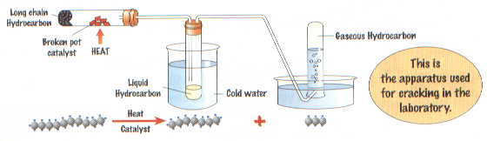
Cracking
This is a THERMAL DECOMPOSITION reaction, with clay used as a catalyst
The trouble is that ANY of the bonds could be broken. For example:
Decane (C₁₀H₂₂) could be cracked to give Octane (C₈H₁₈) and ethene (C₂H₄)
Or…
Decane (C₁₀H₂₂) could be cracked to give hexane (C₆H₁₄) and butene (C₄H₈)

Slide 11
Monomers and Polymers
Here’s ethene again. Ethene is called a MONOMER because it is just one small molecule. We can use ethene to make plastics…
Ethene
Step 1: Break the double bond
Step 2: Add the molecules together:
This molecule is called POLYETHENE, and the process that made it is called POLYMERISATION

Slide 12
Another way of drawing it…
Instead of circles, let’s use letters…
H
H
H
H
H
H
H
H
C
C
C
C
C
C
C
C
H
H
H
H
H
H
H
H
Ethene
Ethene
Poly(e)thene
General formula for addition polymerisation:
n
C
C
C
C
n
H
CH₃
H
CH₃
e.g.
n
C
C
C
C
n
H
H
H
H

Slide 13

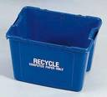




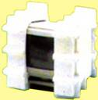
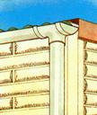
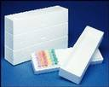

Uses of addition polymers
Poly(ethene)
Poly(propene)
Poly(styrene)
Poly(chloroethene), PVC

Slide 14
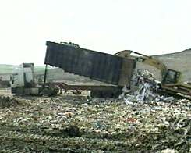
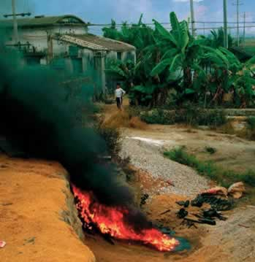
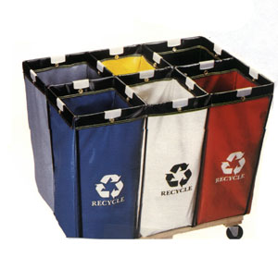
Disposal of plastics
1) Landfill sites - most plastics do not _________ which means that landfill sites are quickly filled up. Research is being carried out on __________ plastics.
2) Burning – this releases carbon dioxide which causes the ________ effect, as well as other ________ gases.
3) _______ – the best option, but difficult because of the different types of plastic
Words – recycling, greenhouse, decompose, biodegradable, poisonous

Slide 15
Structure of Plastics
1) Some plastics have ____ intermolecular forces between each molecule – these have __ melting points and can be ________ easily
2) Some plastics have _____ forces between each molecule. These have ____ melting points and are ____.
Words – high, low, strong, weak, stretched, rigid

Slide 16
Bonding
Cl
Hi. My name’s Johnny Chlorine. I’m in Group 7, so I have 7 electrons in my outer shell
I’d quite like to have a full outer shell. To do this I need to GAIN an electron. Who can help me?
Cl

Slide 17
Bonding
Cl
Here comes one of my friends, Harry Hydrogen
Hey Johnny. I’ve only got one electron but it’s really close to my nucleus so I don’t want to lose it. Fancy sharing?
H
Cl
H
Now we’re both really stable. We’ve formed a covalent bond.

Slide 18
Covalent bonding
Consider an atom of hydrogen:
Notice that hydrogen has just __ electron in its outer shell. A full (inner) shell would have __ electrons, so two hydrogen atoms get together and “_____” their electrons:
Now they both have a ____ outer shell and are more _____. The formula for this molecule is H₂.
When two or more atoms bond by sharing electrons we call it ____________ BONDING. This type of bonding normally occurs between _______ atoms. It causes the atoms in a molecule to be held together very strongly but there are ____ forces between individual molecules. This is why covalently-bonded molecules have low melting and boiling points (i.e. they are usually ____ or ______).
Words – gas, covalent, non-metal, 1, 2, liquid, share, full, weak, stable

Slide 19
Dot and cross diagrams
Water, H₂O:
Step 1: Draw the atoms with their outer shell:
Step 2: Put the atoms together and check they all have a full outer shell:
H
O
H
O
H
H
Oxygen, O₂:
O
O
O
O

Slide 20
Dot and cross diagrams
Nitrogen, N₂:
Methane CH₄:
H
N
N
H
C
H
H
Ammonia NH₃:
Carbon dioxide, CO₂:
H
N
H
O
C
O
H

Slide 21
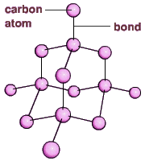
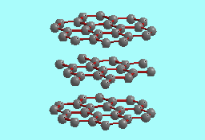
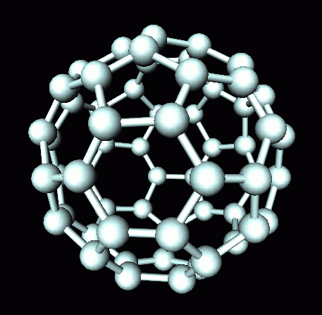
Forms of Carbon
1) Diamond – very hard, doesn’t conduct electricity, very high melting point
2) Graphite – soft, does conduct electricity, very high melting point
3) Buckminsterfullerene – 60 carbon atoms arranged in s sphere

